Slide 1
Higher Order Concurrency for Microcontrollers
Abhiroop Sarkar Chalmers University
Notes:
© Copyright Showeet.com – Creative & Free PowerPoint Templates

Slide 2
My co-authors
Bo Joel Svensson, Robert Krook, Mary Sheeran Chalmers University

Slide 3
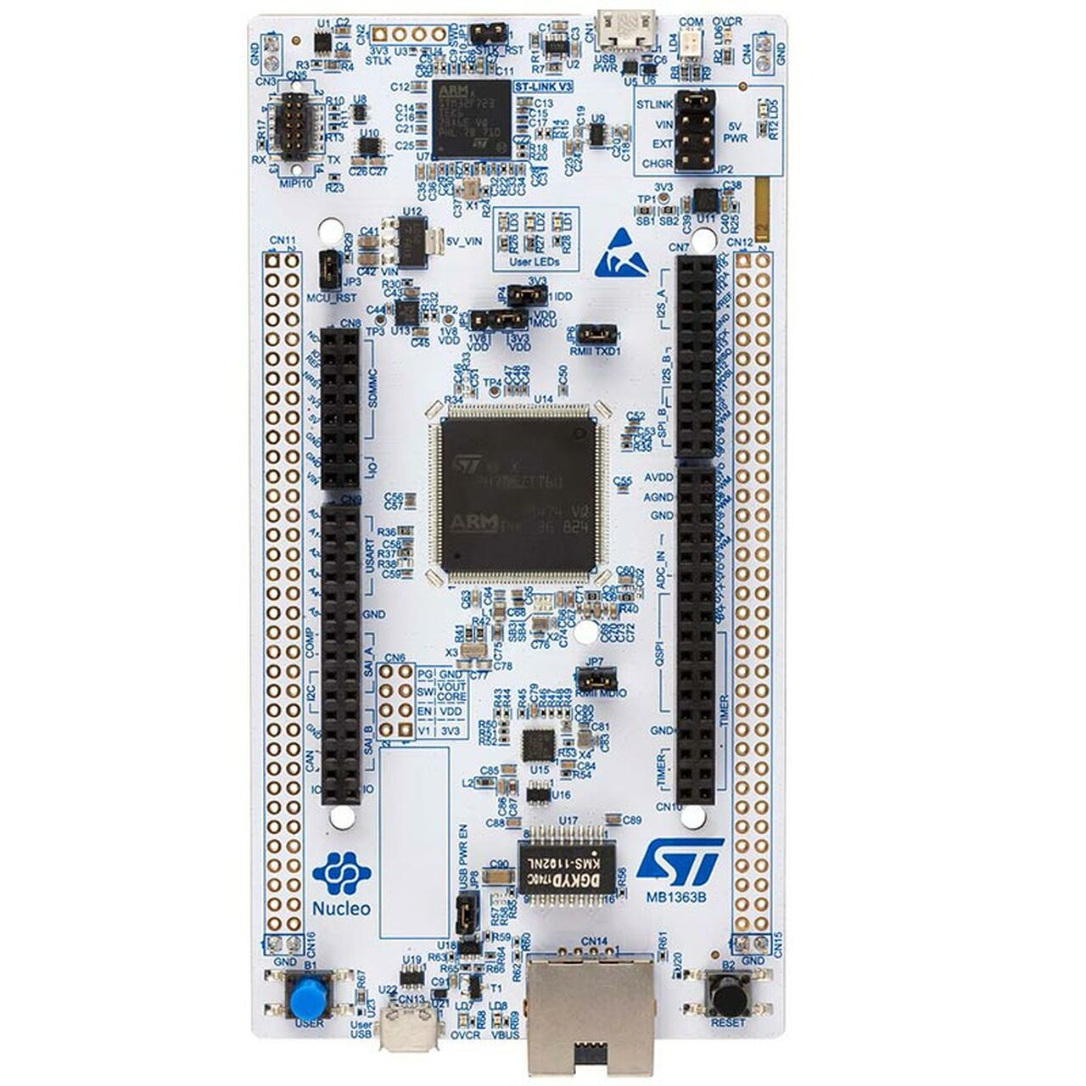
STM32F767
STM32 microcontroller
ARM Cortex-M7 216 MHz clock
512KB RAM
2 MB of flash memory
1$-50$ price range
Ethernet, Board Expansion Connectors
Less sophisticated than a System-on-a-chip
Notes:
© Copyright Showeet.com – Creative & Free PowerPoint Templates

Slide 4
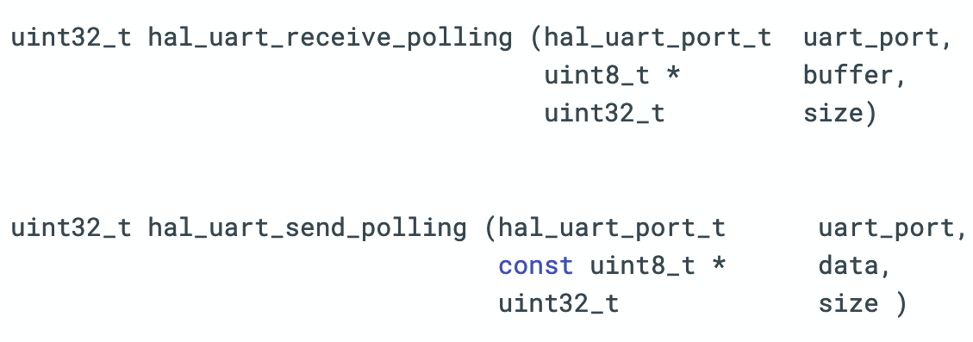
Polling based synchronous APIs
Notes:
© Copyright Showeet.com – Creative & Free PowerPoint Templates

Slide 5
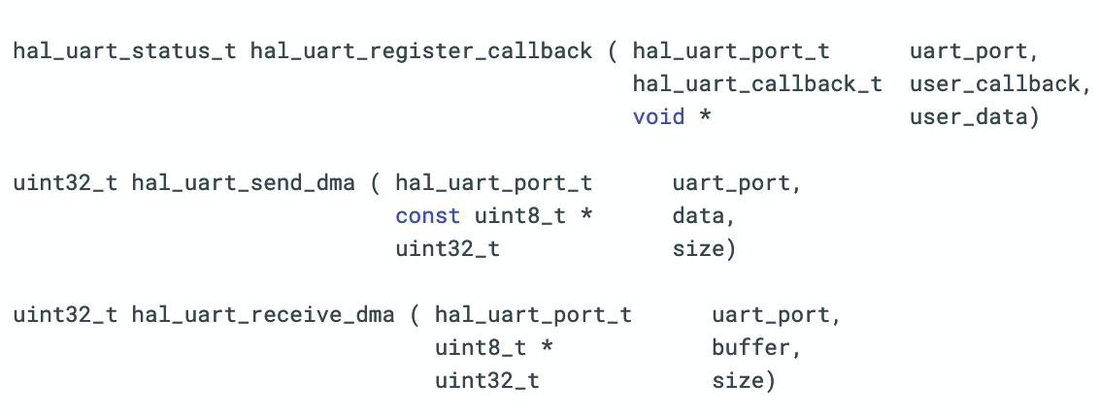
Callback based asynchronous APIs
Notes:
© Copyright Showeet.com – Creative & Free PowerPoint Templates

Slide 6
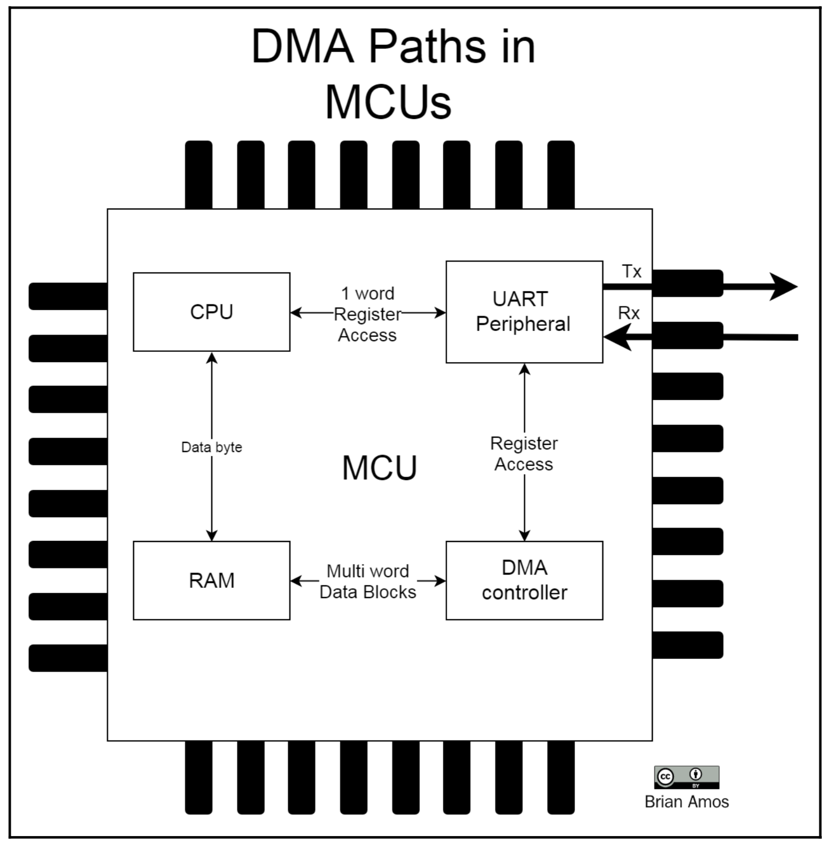
Direct Memory Access (DMA)
Notes:
© Copyright Showeet.com – Creative & Free PowerPoint Templates

Slide 7
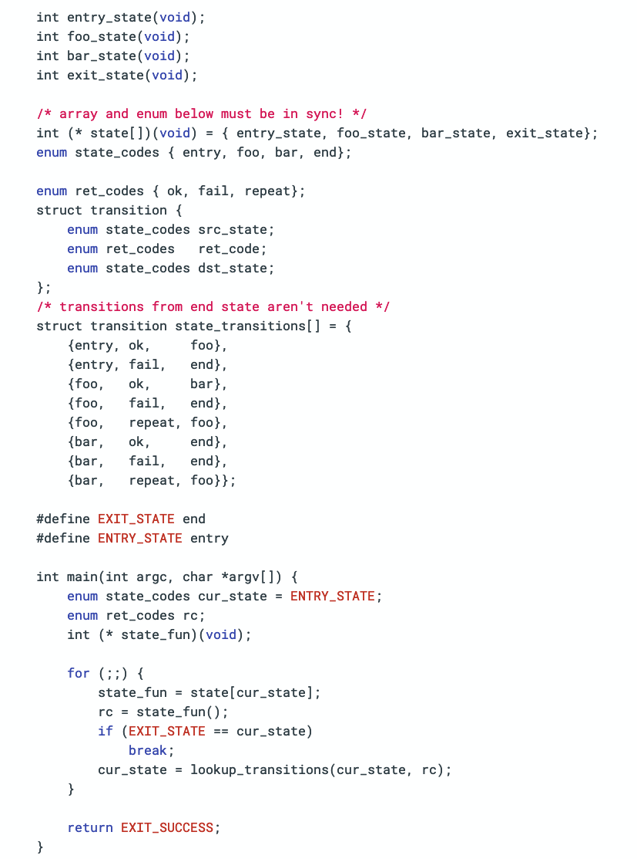
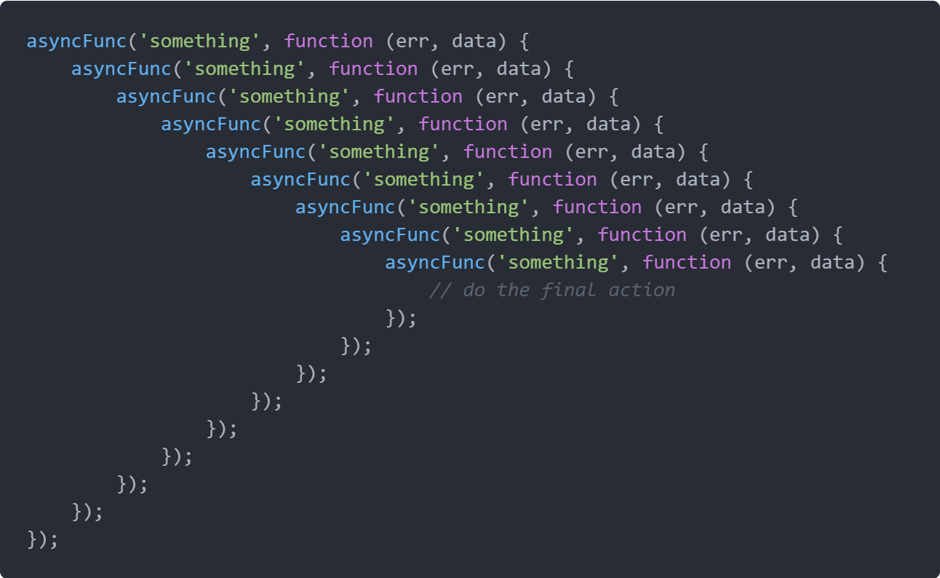
Callback-based programming
Notes:
© Copyright Showeet.com – Creative & Free PowerPoint Templates

Slide 8
Asynchronous callback-based APIs break the linear control flow
Notes:
© Copyright Showeet.com – Creative & Free PowerPoint Templates

Slide 9
Concurrent – multitude of peripherals
Microcontroller programs
I/O centric – leading to asynchrony
SenseVM (MPLR ‘21)
(ongoing work)
Timing aware – related to critical real-time apps
Notes:
© Copyright Showeet.com – Creative & Free PowerPoint Templates

Slide 10
Bytecode-interpreted virtual machine - Categorical Abstract Machine
SenseVM
Mark & Sweep Garbage Collector*
Higher-Order Concurrency Model
Notes:
© Copyright Showeet.com – Creative & Free PowerPoint Templates

Slide 11
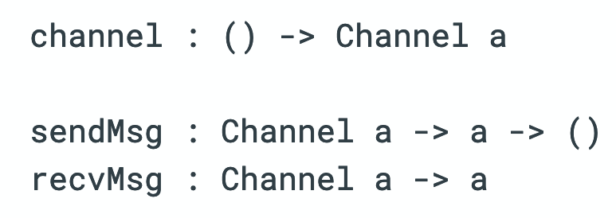
Notes:
© Copyright Showeet.com – Creative & Free PowerPoint Templates

Slide 12
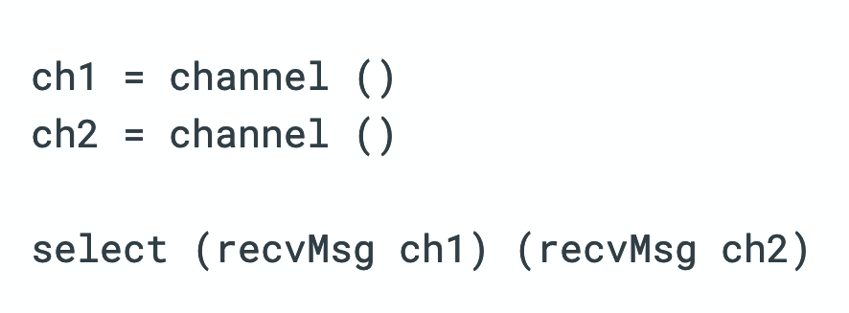
Non-deterministic choice
Notes:
© Copyright Showeet.com – Creative & Free PowerPoint Templates

Slide 13
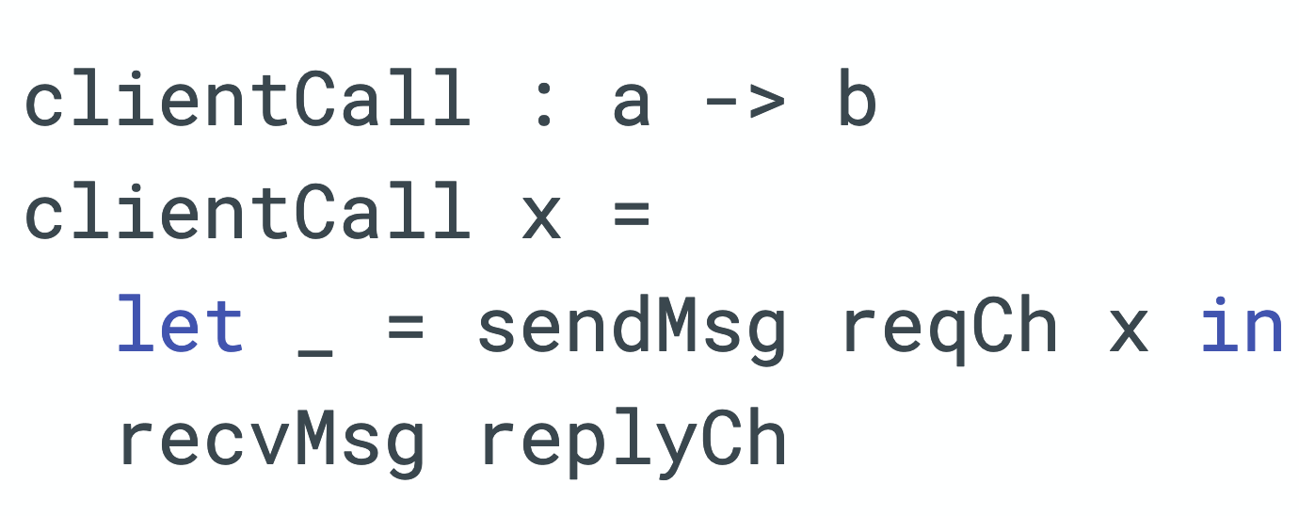
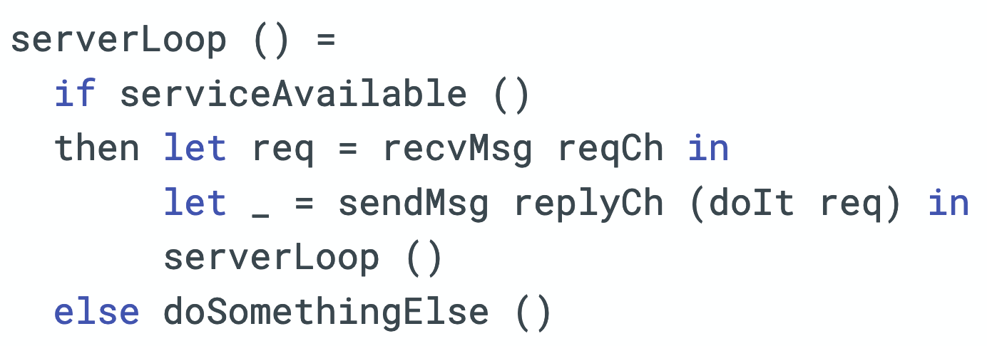
Non-deterministic choice vs Abstraction
Client
Server
We want to “select” on sendMsg
clientCall will block if serviceAvailable returns False blocking the entire client
Notes:
© Copyright Showeet.com – Creative & Free PowerPoint Templates

Slide 14
Procedural abstraction and non-deterministic choice are conflicting goals
Notes:
© Copyright Showeet.com – Creative & Free PowerPoint Templates

Slide 15
Notes:
© Copyright Showeet.com – Creative & Free PowerPoint Templates

Slide 16
Event
Event
Notes:
© Copyright Showeet.com – Creative & Free PowerPoint Templates

Slide 17
Events are composable
Notes:
© Copyright Showeet.com – Creative & Free PowerPoint Templates

Slide 18
Notes:
© Copyright Showeet.com – Creative & Free PowerPoint Templates

Slide 19
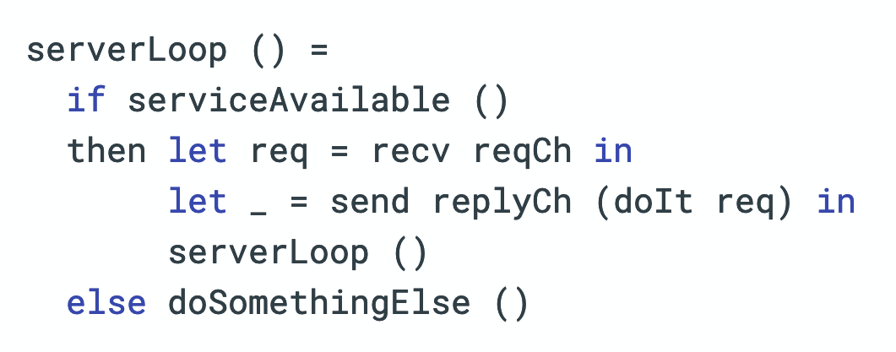
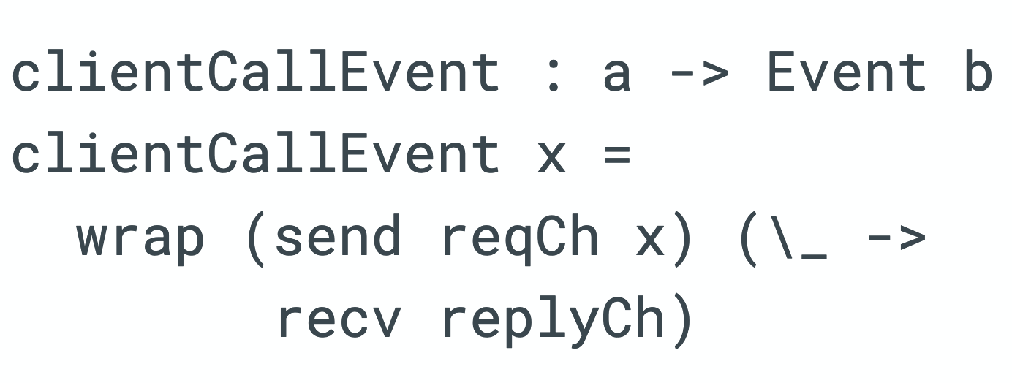
Abstraction + Choice
Client
Server
VS
Notes:
© Copyright Showeet.com – Creative & Free PowerPoint Templates

Slide 20
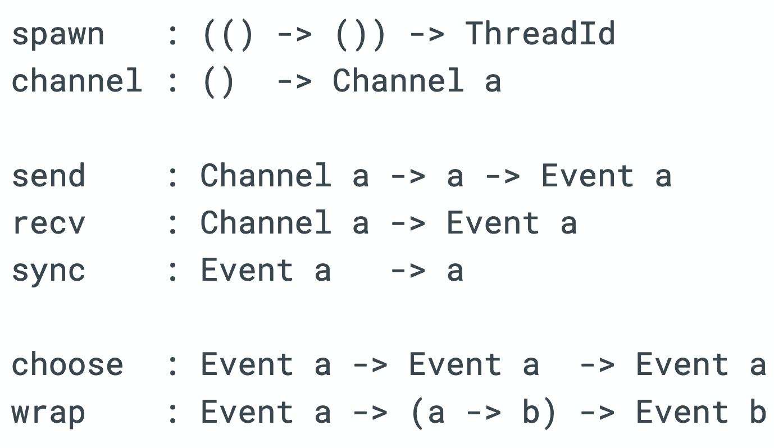
Higher-Order Concurrency
Notes:
© Copyright Showeet.com – Creative & Free PowerPoint Templates

Slide 21
Drivers and I/O
Queues, Buffers, Backpressure..
Higher-Order Concurrency
Notes:
© Copyright Showeet.com – Creative & Free PowerPoint Templates

Slide 22
Notes:
© Copyright Showeet.com – Creative & Free PowerPoint Templates

Slide 23
Drivers and I/O
Queues, Buffers, Backpressure..
Higher-Order Concurrency
Notes:
© Copyright Showeet.com – Creative & Free PowerPoint Templates

Slide 24
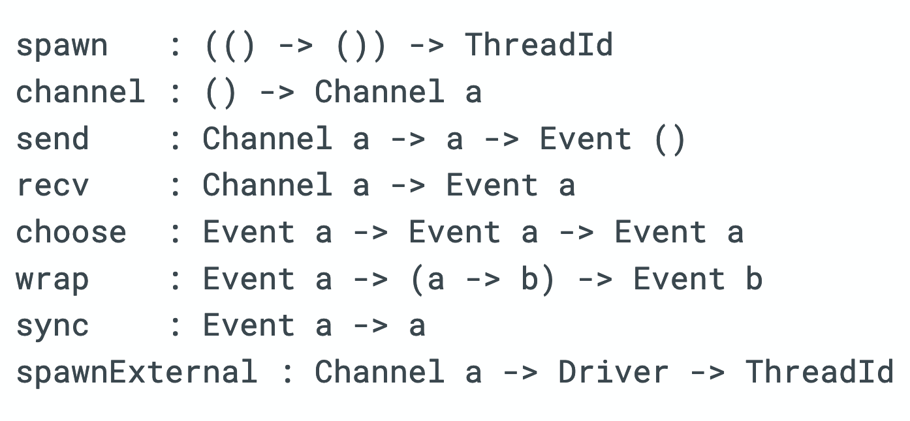
Higher-Order Concurrency in SenseVM
Notes:
© Copyright Showeet.com – Creative & Free PowerPoint Templates

Slide 25
Button-Blinky Blink an LED when a button is pressed
Notes:
© Copyright Showeet.com – Creative & Free PowerPoint Templates

Slide 26
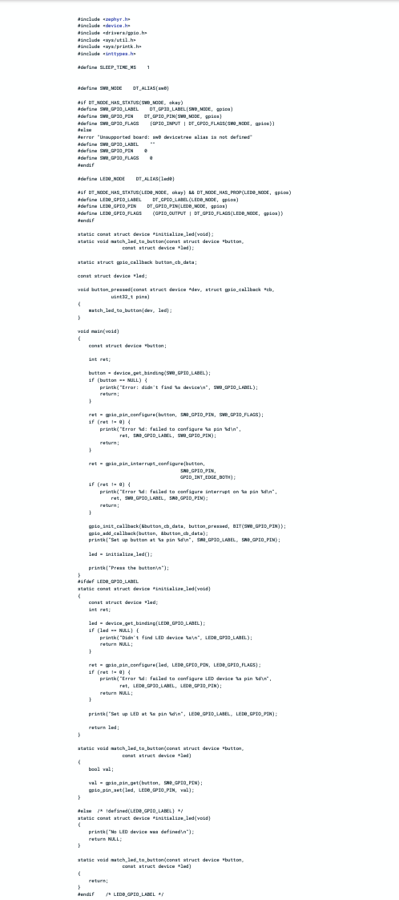
Notes:
© Copyright Showeet.com – Creative & Free PowerPoint Templates

Slide 27
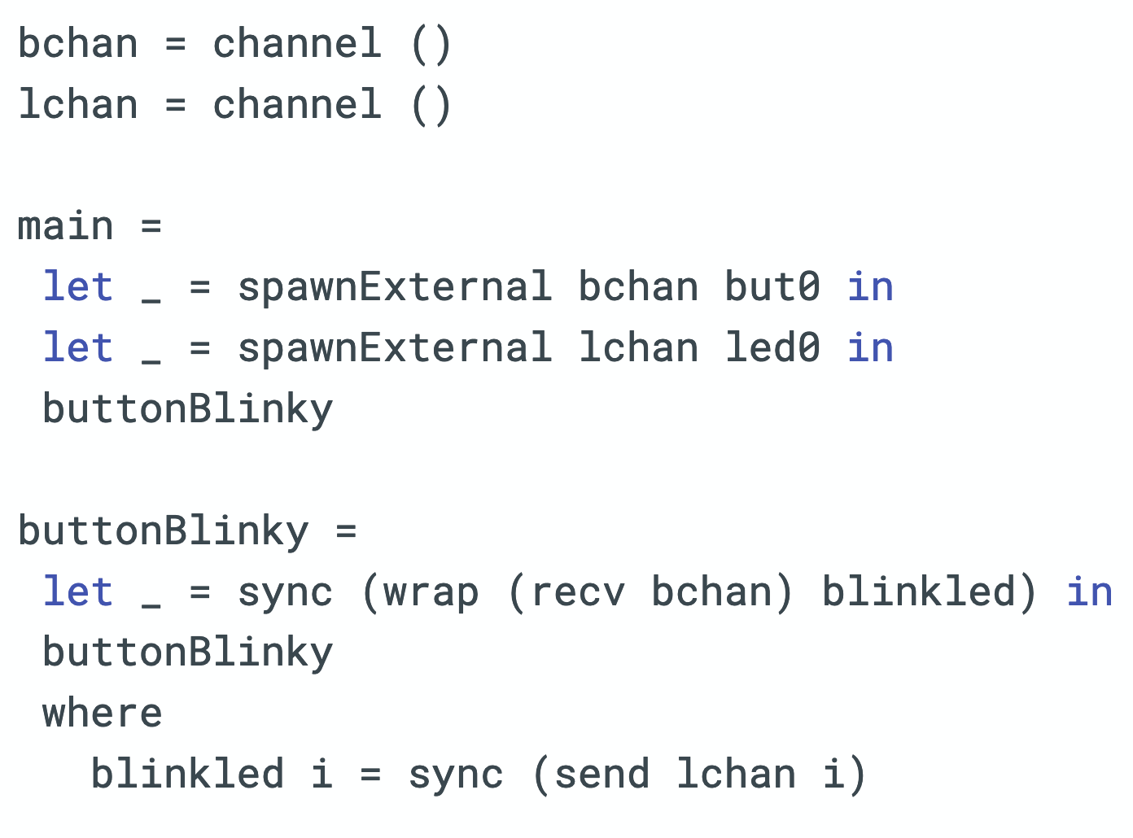
Button-Blinky
Notes:
© Copyright Showeet.com – Creative & Free PowerPoint Templates

Slide 28
Notes:
© Copyright Showeet.com – Creative & Free PowerPoint Templates

Slide 29
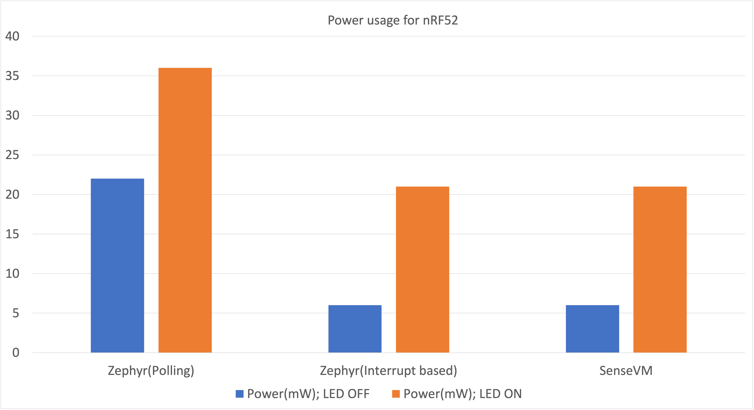
Notes:
© Copyright Showeet.com – Creative & Free PowerPoint Templates

Slide 30
Notes:
© Copyright Showeet.com – Creative & Free PowerPoint Templates

Slide 31
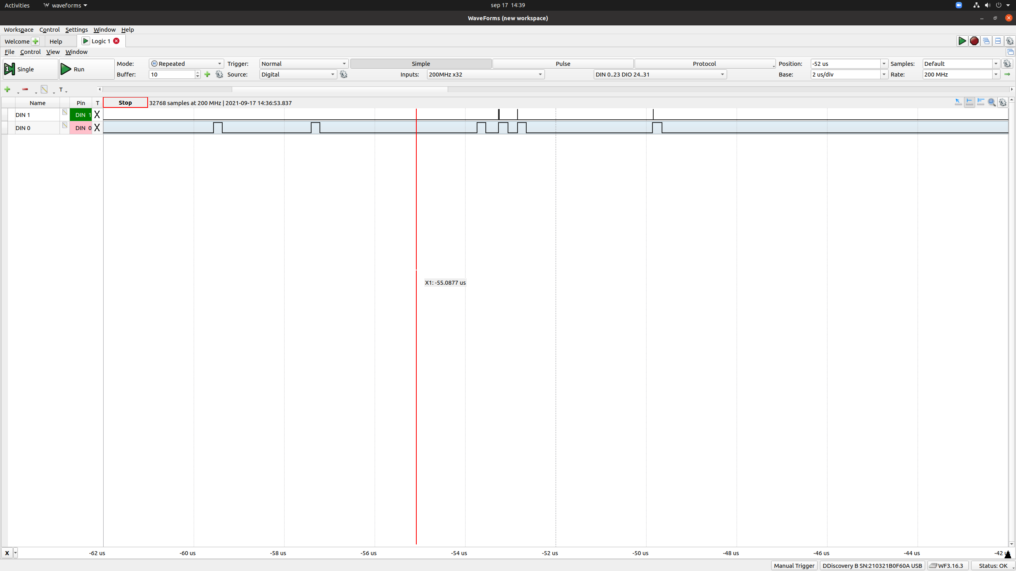
Notes:
© Copyright Showeet.com – Creative & Free PowerPoint Templates

Slide 32
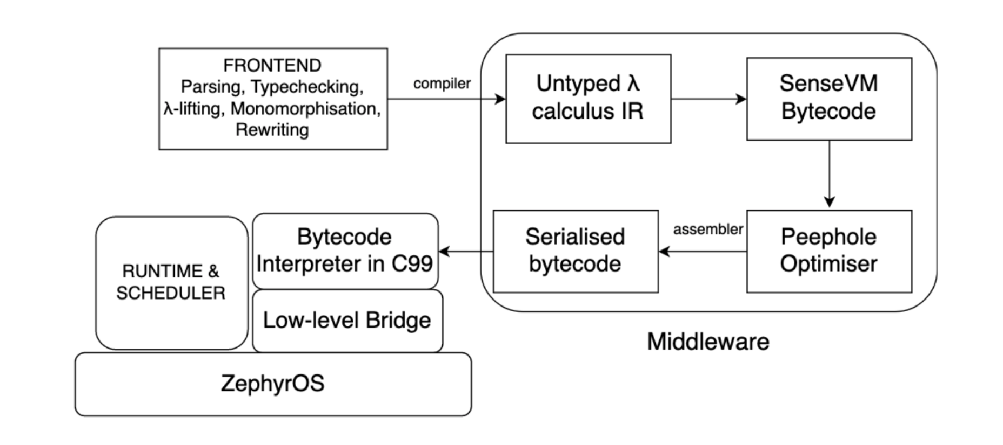
Implementation
Notes:
© Copyright Showeet.com – Creative & Free PowerPoint Templates

Slide 33
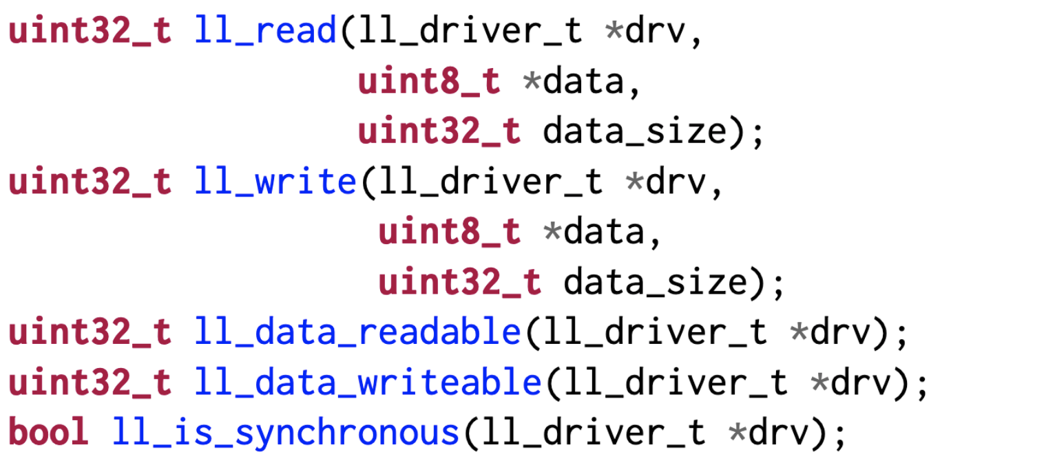
Low-level Bridge
Notes:
© Copyright Showeet.com – Creative & Free PowerPoint Templates

Slide 34
Currently supported drivers (nRF52, STM32)
LED
DAC
Button
I2C sensor (light)
SPI sensor (humidity, temperature, pressure)
More drivers in the future..
Notes:
© Copyright Showeet.com – Creative & Free PowerPoint Templates

Slide 35
Future Work
Real-Time Higher-Order Concurrency Memory Management alternatives
- Regions - Reference Counting Security - Capability based privileges - Sandboxing/Containers
Notes:
© Copyright Showeet.com – Creative & Free PowerPoint Templates

Slide 36
Thank you!
Contact: sarkara@chalmers.se, joels@chalmers.se, mary.sheeran@chalmers.se, krookr@chalmers.se
Notes:
© Copyright Showeet.com – Creative & Free PowerPoint Templates

