Slide 1
Hailstorm : A functional language for IoT applications
Secure Programming
of IoT Devices
Abhiroop Sarkar
Mary Sheeran
Notes:
© Copyright Showeet.com – Creative & Free PowerPoint Templates

Slide 2
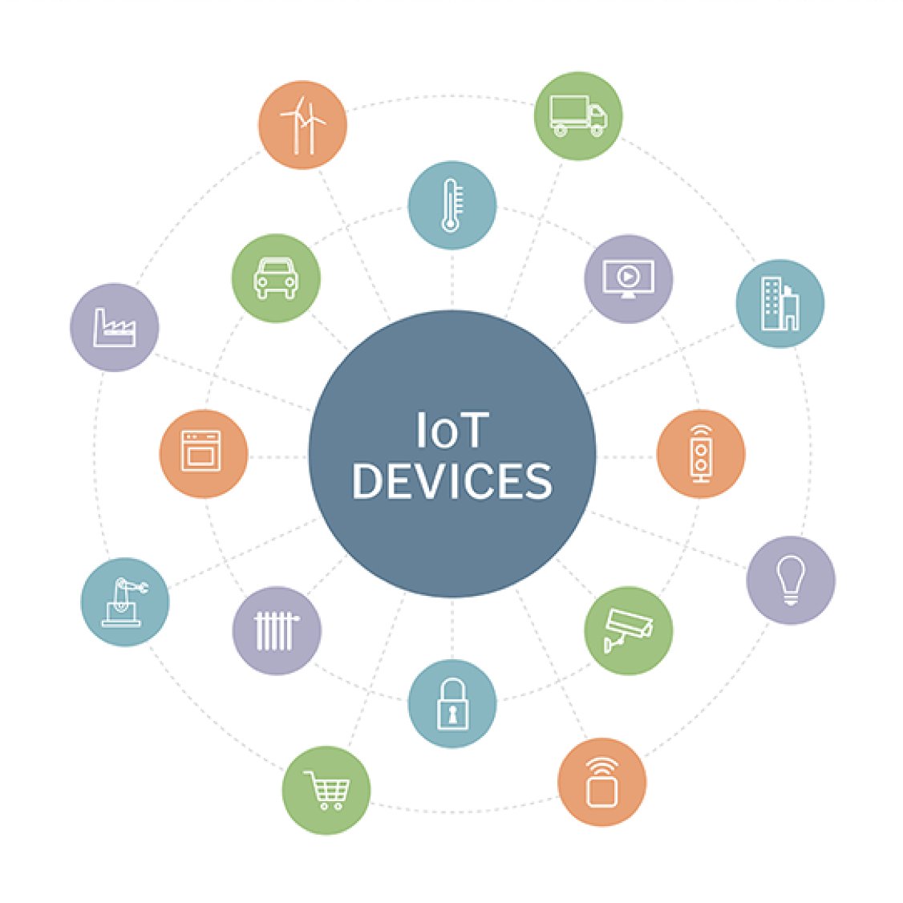
Diverse Applications
31 billion devices in 2020*
Notes:
© Copyright Showeet.com – Creative & Free PowerPoint Templates

Slide 3
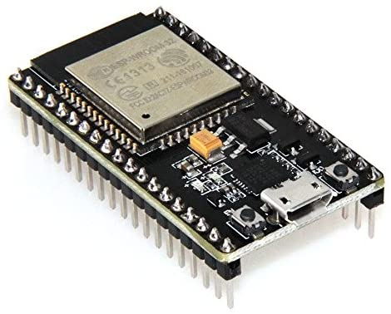
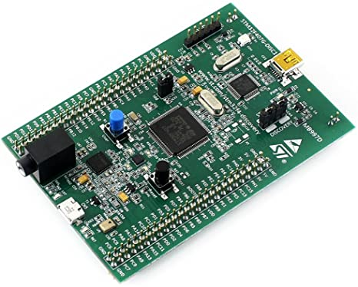
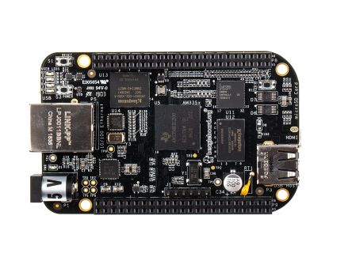
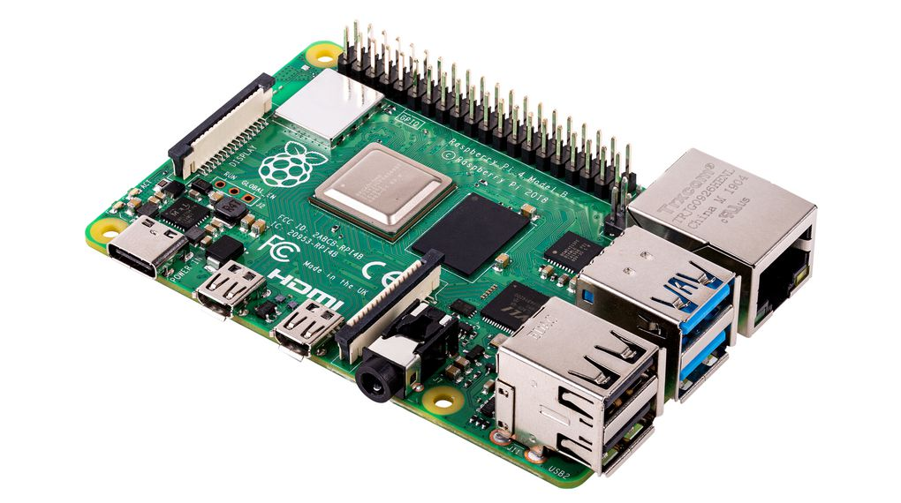
Diverse applications leads to Diverse architectures and systems
ESP32 – 520KB SRAM, BLE, WiFi
STM32 - 4KB to 1MB SRAM
BeagleBoards - 64MB to 512MB
Raspberry Pi - 256MB to 8GB!!
…
02
Notes:
© Copyright Showeet.com – Creative & Free PowerPoint Templates

Slide 4
C
How do we program such a wide variety of devices?
Notes:
© Copyright Showeet.com – Creative & Free PowerPoint Templates

Slide 5
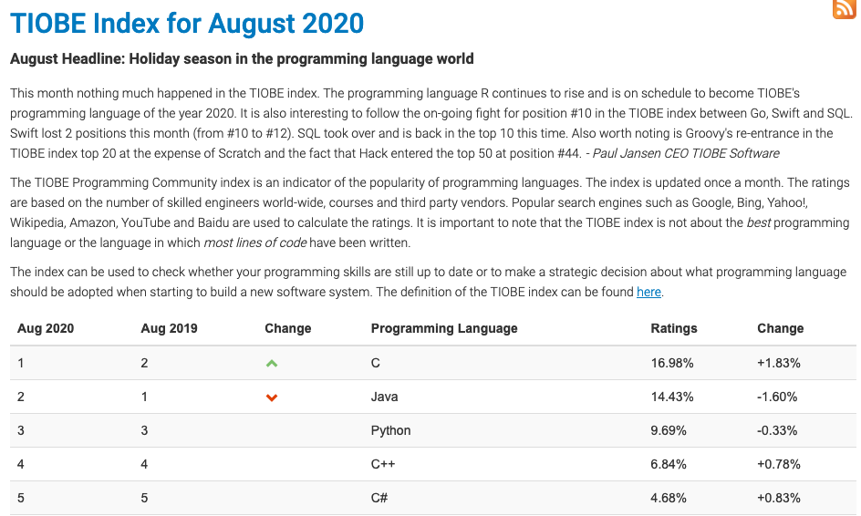
Notes:
© Copyright Showeet.com – Creative & Free PowerPoint Templates

Slide 6
Motivation Program IoT in high level languages
Notes:
© Copyright Showeet.com – Creative & Free PowerPoint Templates

Slide 7
Hailstorm❄️
HaSki*
*Valliappan et. al. - Towards Secure IoT Programming in Haskell. HASKELL 2020

Slide 8
Hailstorm
Functional Programming Language
Pure
Statically-Typed
Call-by-value
DSL (not embedded)
Notes:
© Copyright Showeet.com – Creative & Free PowerPoint Templates

Slide 9
Properties of Hailstorm
Purity
Enables optimizations
Security
Static Information Flow Control*
Static-Typing
Track information in the type system
Notes:
© Copyright Showeet.com – Creative & Free PowerPoint Templates

Slide 10
Effects
Notes:
© Copyright Showeet.com – Creative & Free PowerPoint Templates

Slide 11
Infinite stream model
Input stream
Composition of pure functions
Output stream
Logical timestep
Old Haskell I/O - main :: [Response] → [Request]
Non-modular I/O driven programs
Non-extensible
Notes:
© Copyright Showeet.com – Creative & Free PowerPoint Templates

Slide 12
EDSLs
Accelerate, Raw-Feldspar, HaSki,…
Notes:
© Copyright Showeet.com – Creative & Free PowerPoint Templates

Slide 13
Arrowized FRP*
Notes:
© Copyright Showeet.com – Creative & Free PowerPoint Templates

Slide 14
Can AFRP signals represent real world signals?
Notes:
© Copyright Showeet.com – Creative & Free PowerPoint Templates

Slide 15
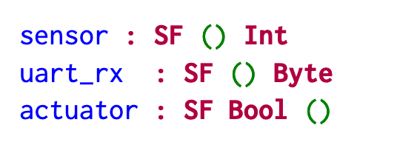
Notes:
© Copyright Showeet.com – Creative & Free PowerPoint Templates

Slide 16
Notes:
© Copyright Showeet.com – Creative & Free PowerPoint Templates

Slide 17
Resource Types*
Notes:
© Copyright Showeet.com – Creative & Free PowerPoint Templates

Slide 18
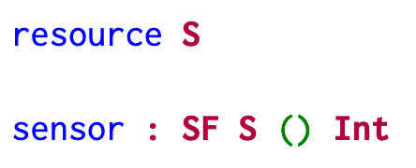
Notes:
© Copyright Showeet.com – Creative & Free PowerPoint Templates

Slide 19
Notes:
© Copyright Showeet.com – Creative & Free PowerPoint Templates

Slide 20
Notes:
© Copyright Showeet.com – Creative & Free PowerPoint Templates

Slide 21
Notes:
© Copyright Showeet.com – Creative & Free PowerPoint Templates

Slide 22
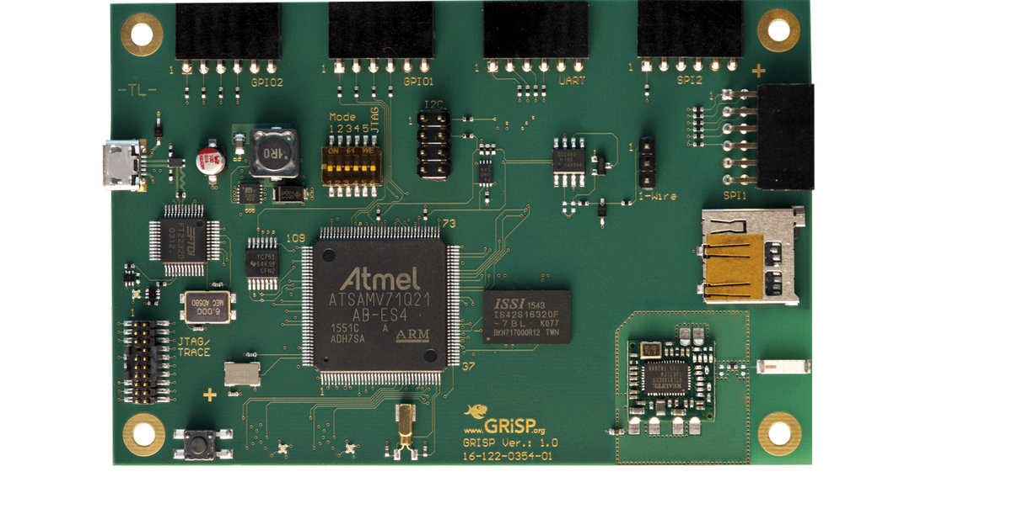
Hello World!
Notes:
© Copyright Showeet.com – Creative & Free PowerPoint Templates

Slide 23
Notes:
© Copyright Showeet.com – Creative & Free PowerPoint Templates

Slide 24
Notes:
© Copyright Showeet.com – Creative & Free PowerPoint Templates

Slide 25
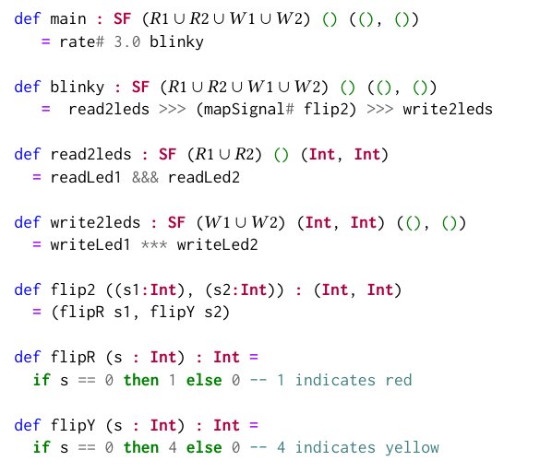
Synchronous blinking
Notes:
© Copyright Showeet.com – Creative & Free PowerPoint Templates

Slide 26
Notes:
© Copyright Showeet.com – Creative & Free PowerPoint Templates

Slide 27
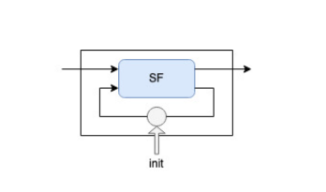
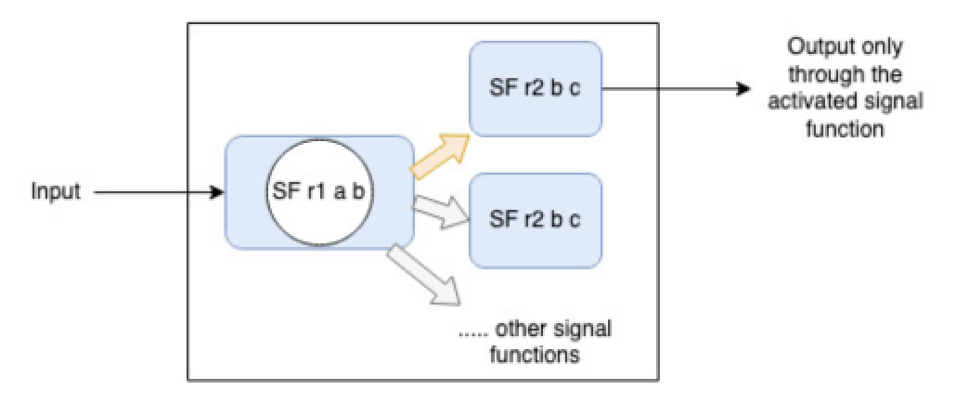
More combinators and case studies in the paper
Earthquake detector
Traffic Signal Controller
Watchdog
Railway Track Controller
Notes:
© Copyright Showeet.com – Creative & Free PowerPoint Templates

Slide 28
❄️
Notes:
© Copyright Showeet.com – Creative & Free PowerPoint Templates

Slide 29
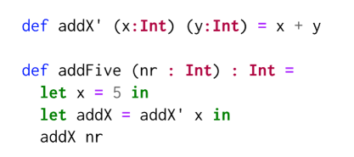
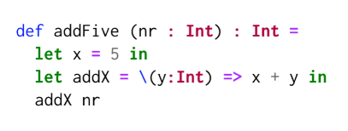
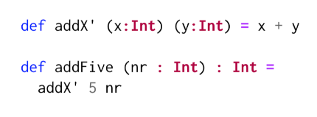
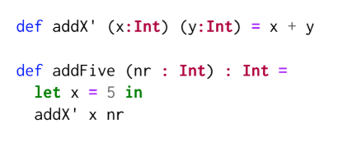
Lambda Lifting
Inlining
Inlining
Notes:
© Copyright Showeet.com – Creative & Free PowerPoint Templates

Slide 30
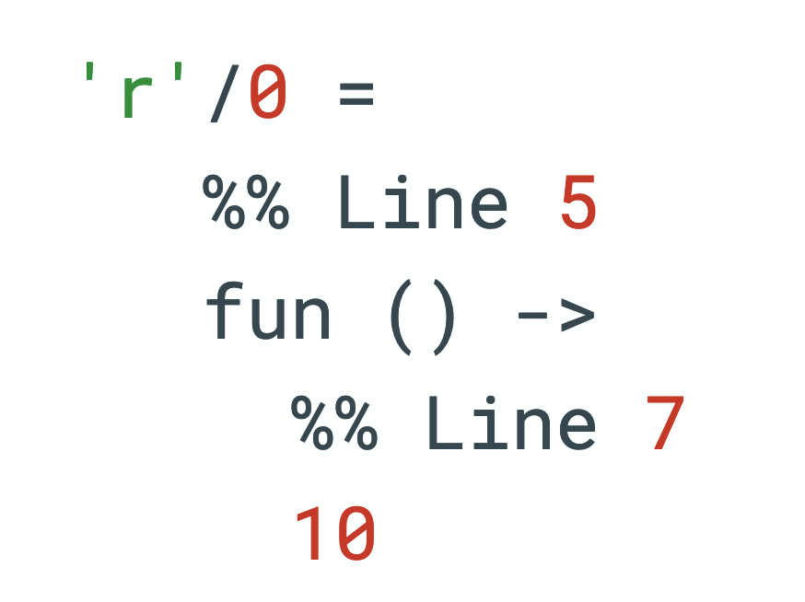
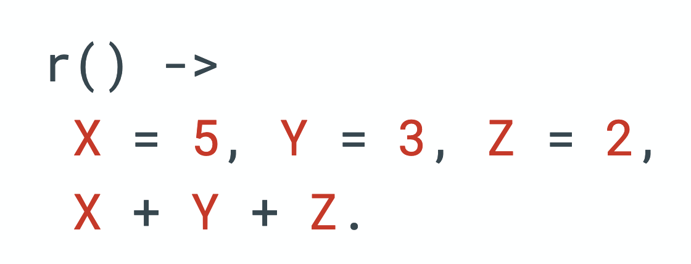
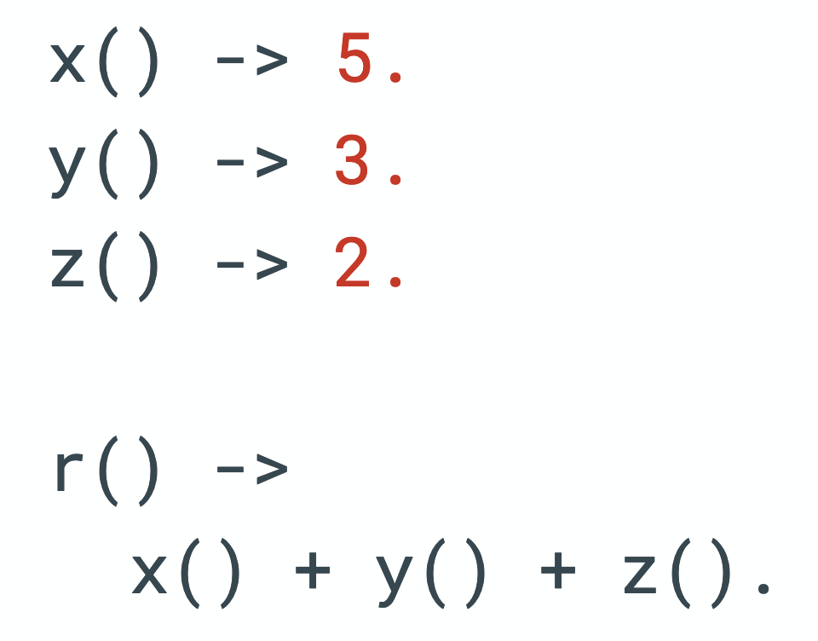
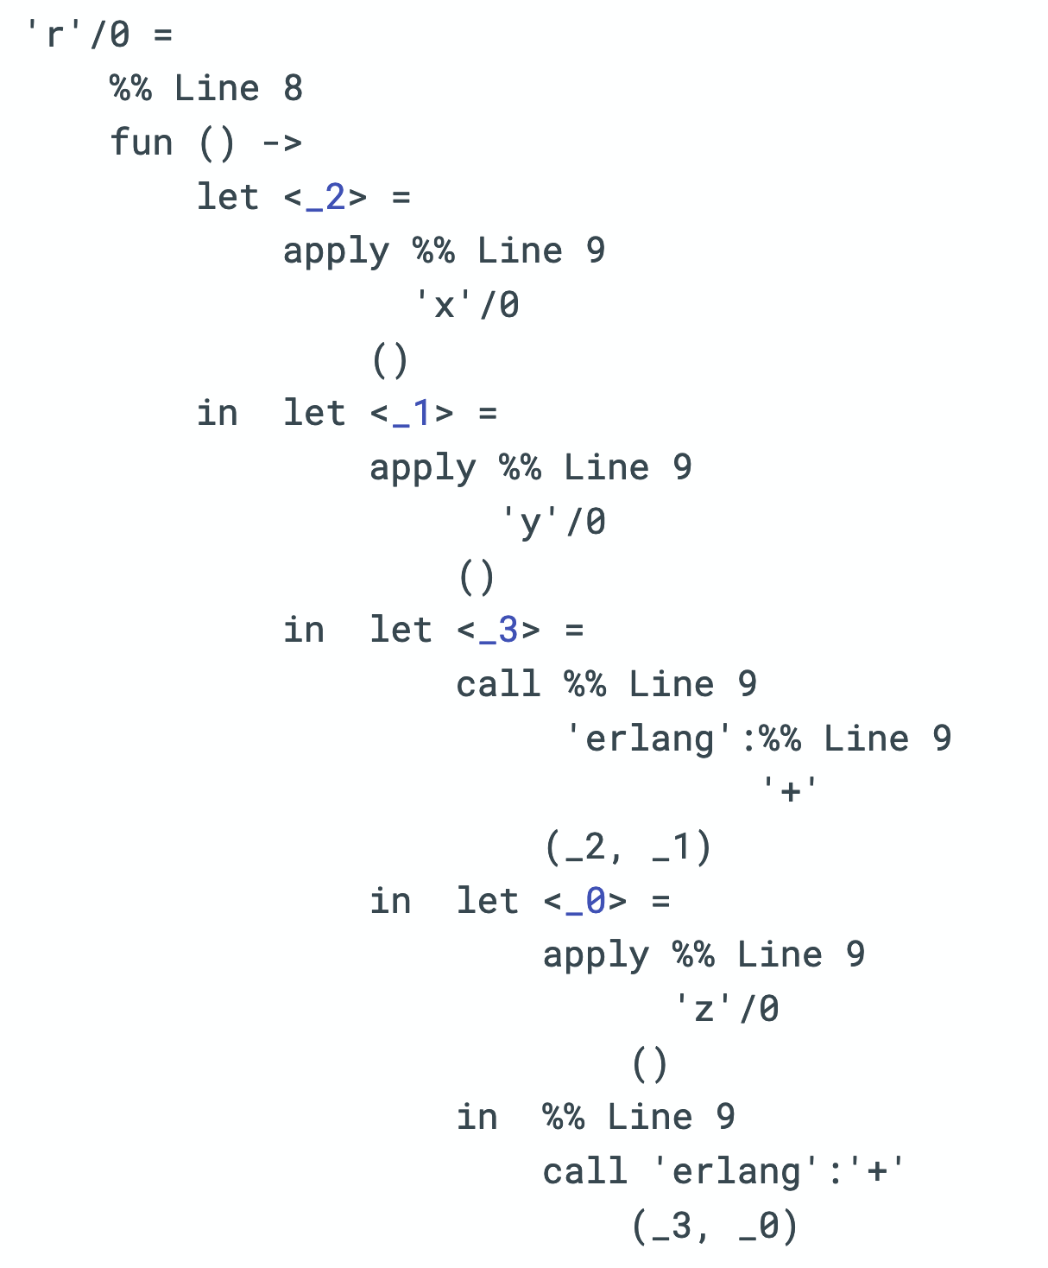
Inlines
Does not inline
Notes:
© Copyright Showeet.com – Creative & Free PowerPoint Templates

Slide 31
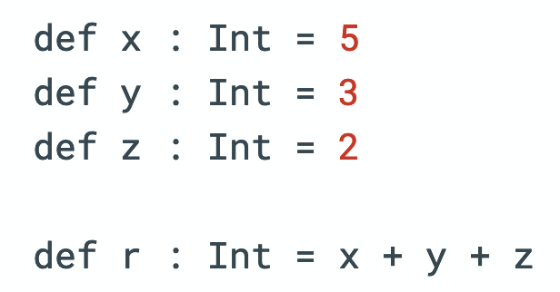
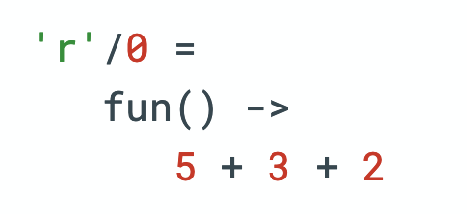
Inlines
Notes:
© Copyright Showeet.com – Creative & Free PowerPoint Templates

Slide 32
Pull based semantics
Notes:
© Copyright Showeet.com – Creative & Free PowerPoint Templates

Slide 33
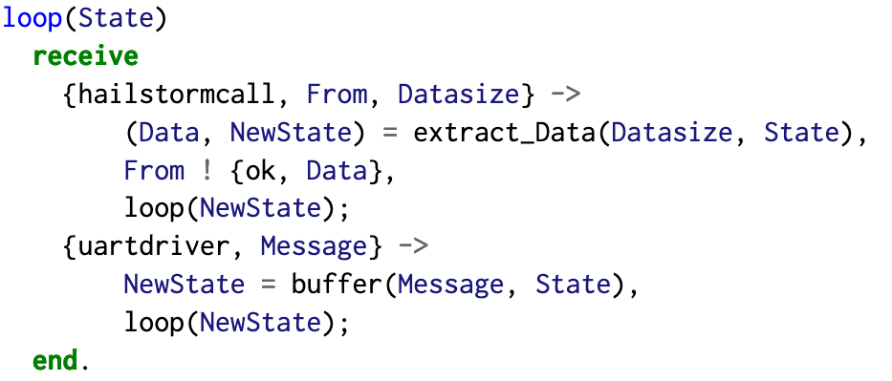
Notes:
© Copyright Showeet.com – Creative & Free PowerPoint Templates

Slide 34
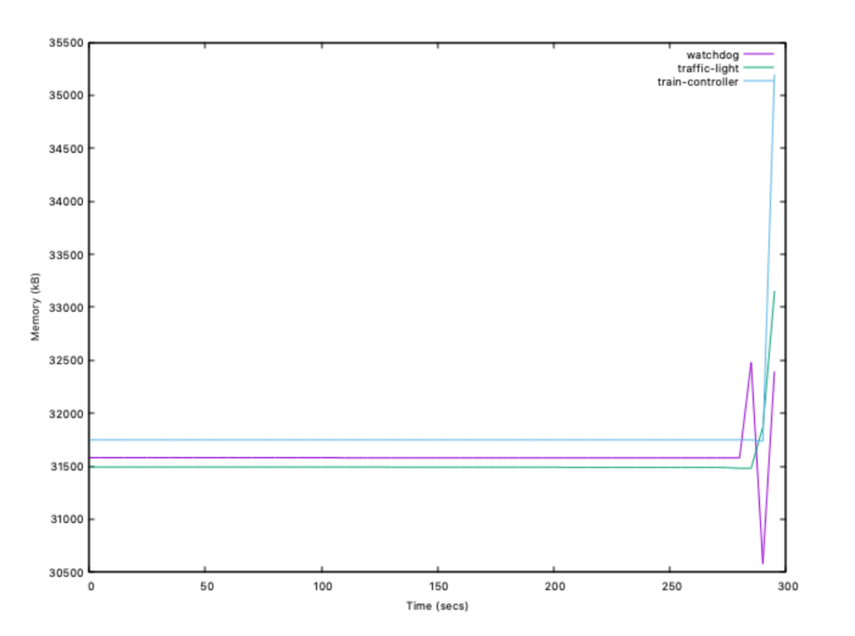
Microbenchmarks
 | Run 1(ms) | Run 2(ms) | Run 3(ms)
Watchdog | 7.7 | 8.65 | 11.4
Traffic light | 3.81 | 3.04 | 2.12
Train controller | 29.72 | 28.05 | 29.8
Response time including I/O
 | Run 1(𝜇s) | Run 2(𝜇s) | Run 3(𝜇s)
Watchdog | 97.3 | 106.7 | 98.7
Traffic light | 110.8 | 120.2 | 115.1
Train controller | 144.3 | 128.1 | 138.7
Response time excluding I/O
Notes:
© Copyright Showeet.com – Creative & Free PowerPoint Templates

Slide 35
Future work
Sense VM
Bytecode interpreter for eager static typed functional languages
Security
Portability
STM32, ESP32,…
Foreign Function Interface
Notes:
© Copyright Showeet.com – Creative & Free PowerPoint Templates

Slide 36
Related work
Velox VM
FRP
… more details in the paper
Notes:
© Copyright Showeet.com – Creative & Free PowerPoint Templates

Slide 37
Thank You!
sarkara@chalmers.se
https://abhiroop.github.io/pubs/hailstorm/
Do you have any questions?
Photo credit: PeterArreola via Pixabay (Creative Commons Zero license)
Notes:
© Copyright Showeet.com – Creative & Free PowerPoint Templates

